Slide 1
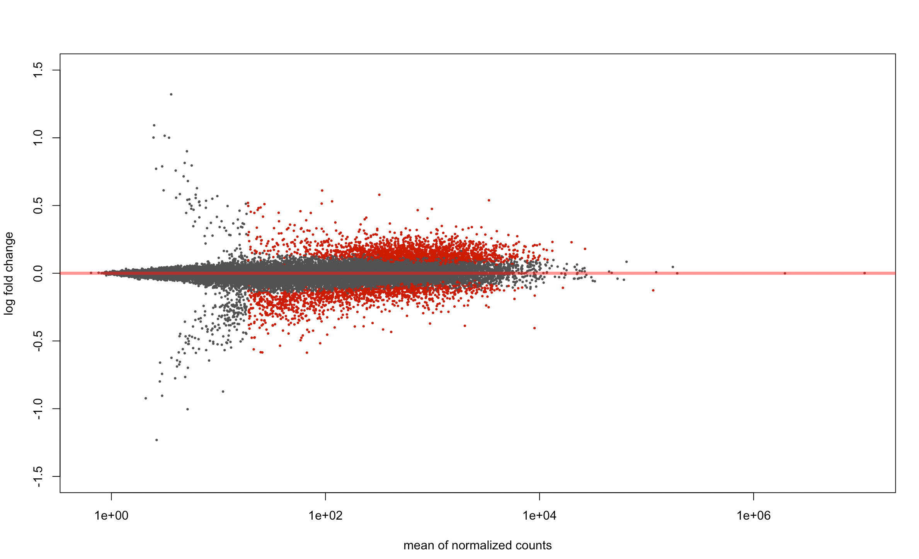
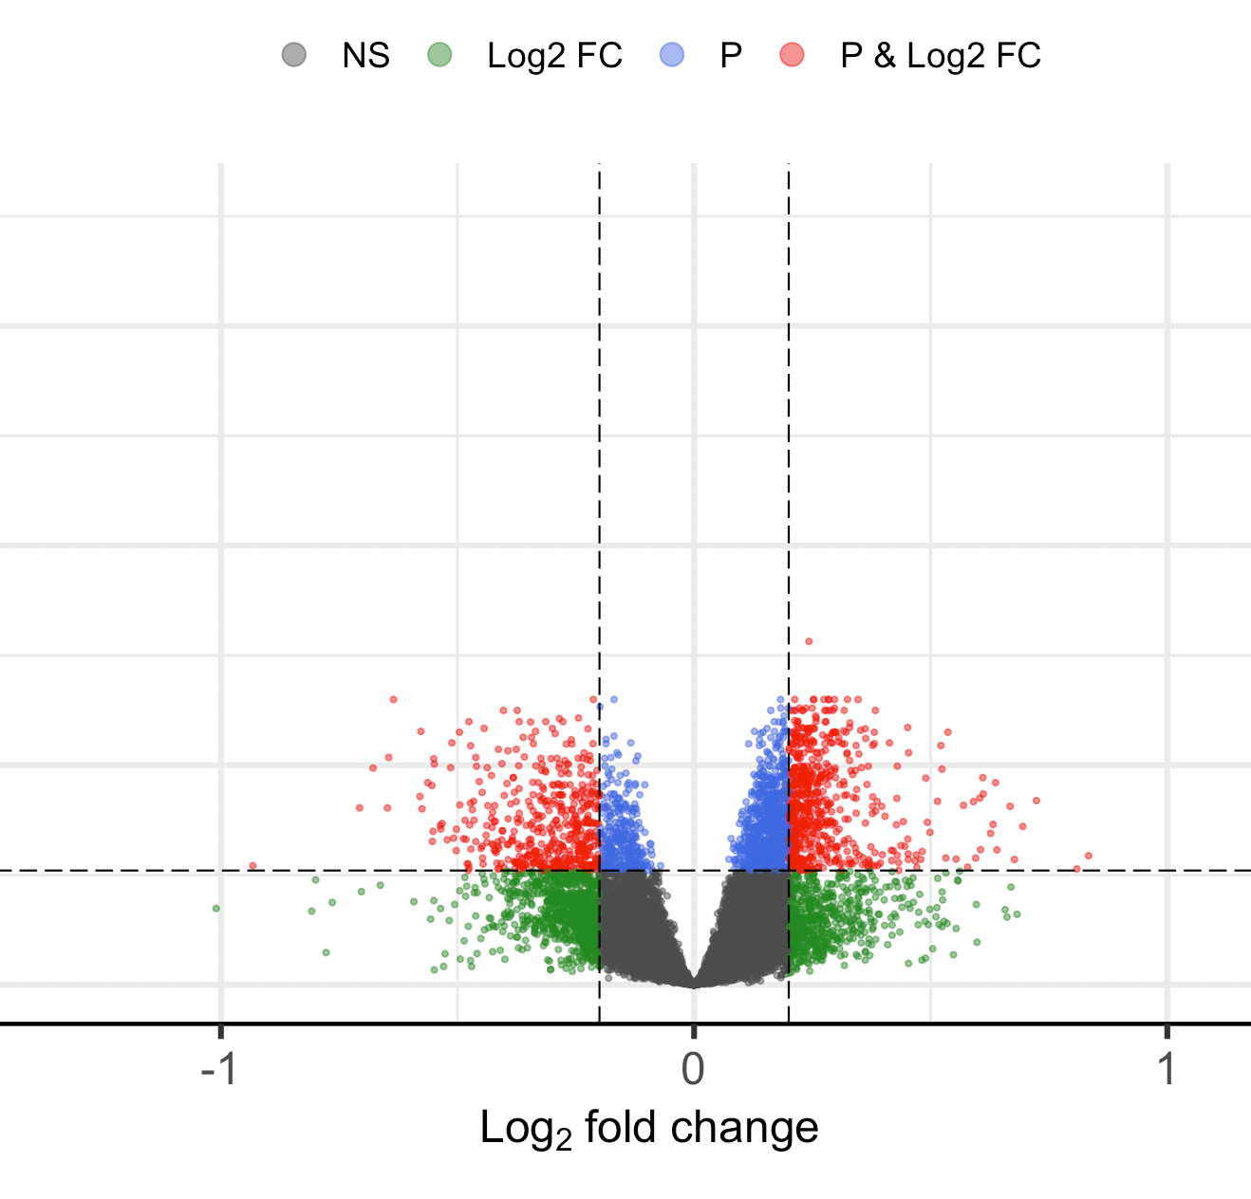
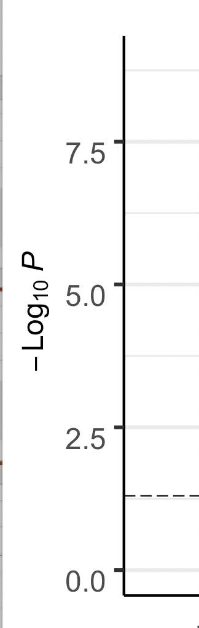
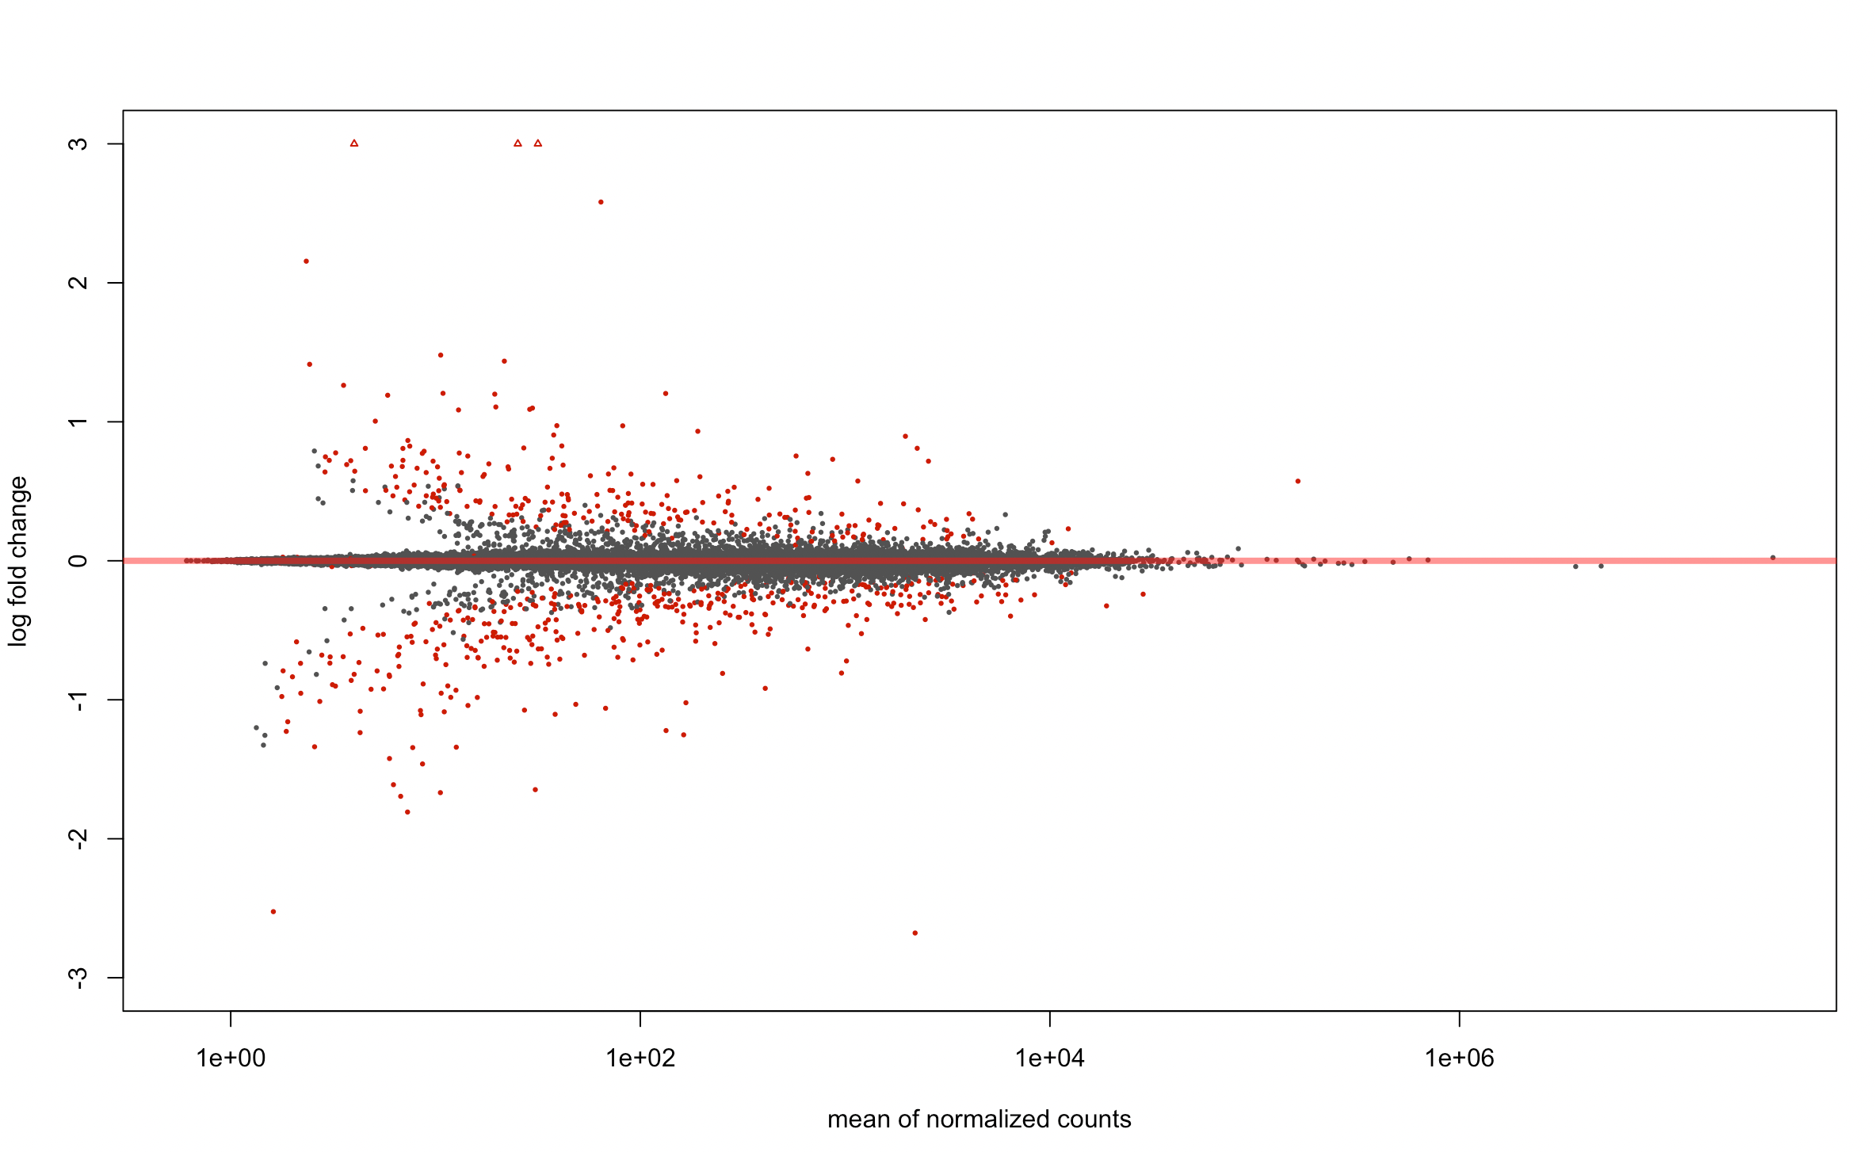
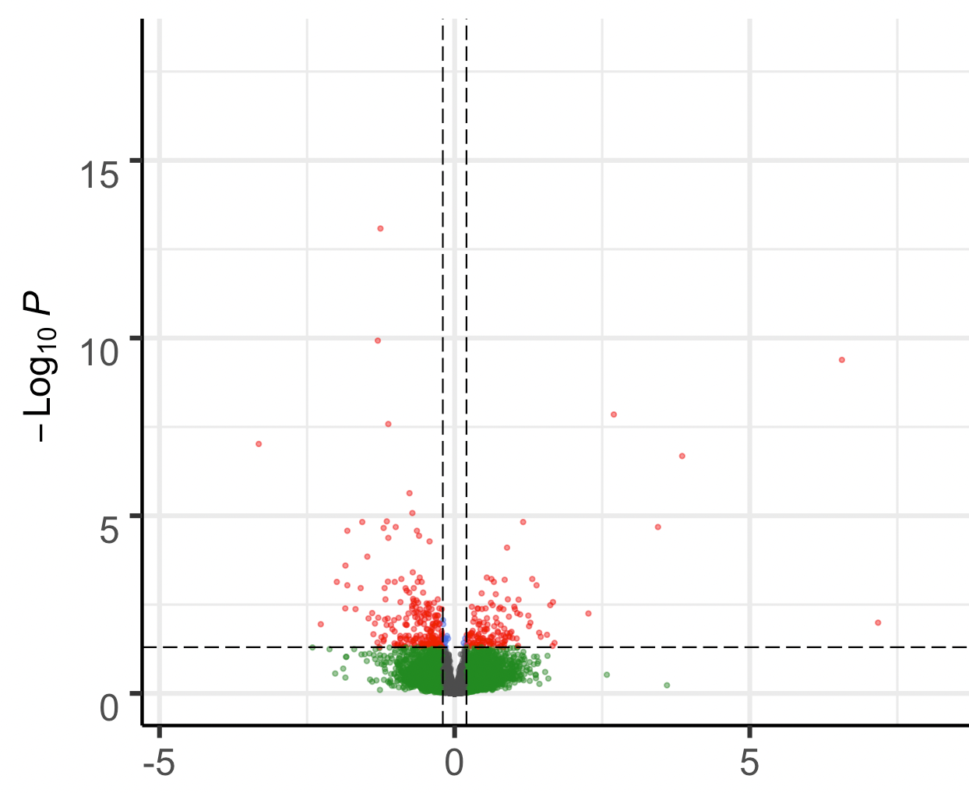
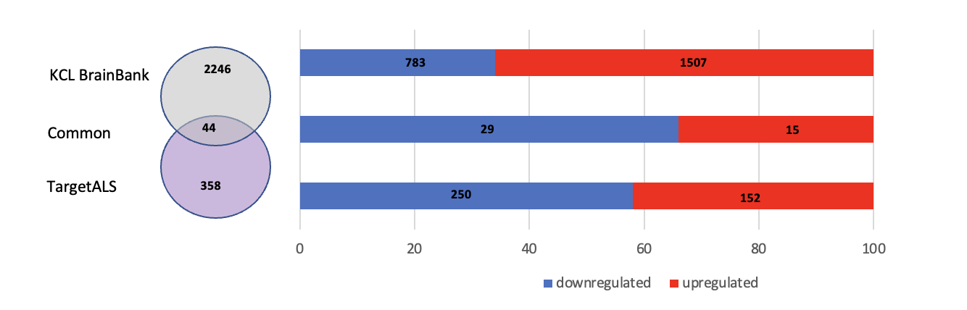
A
B
Log fold change
1e+00 1e+0.2 1e+0.4 1e+0.6
C
Mean of Normalised Values
D
Log₂ Fold Change
Log fold change
1e+00 1e+0.2 1e+0.4 1e+0.6
Log₂ Fold Change
E
Mean of Normalised Values

Slide 2
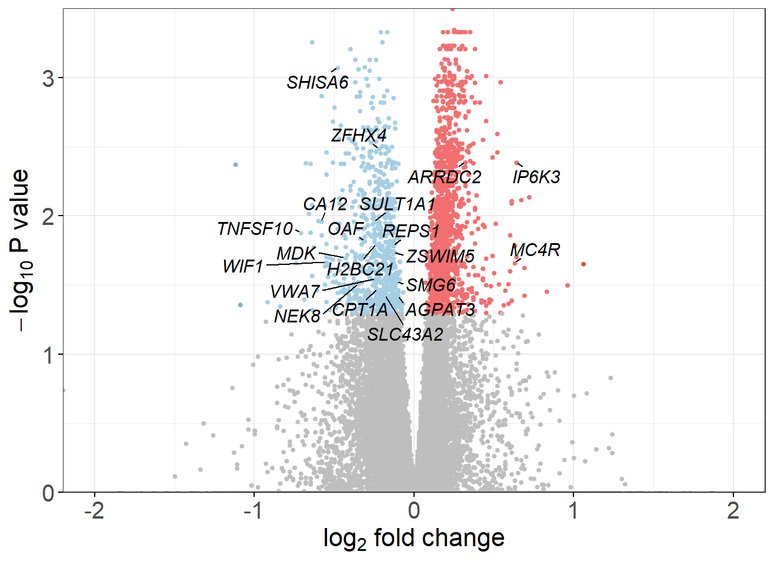
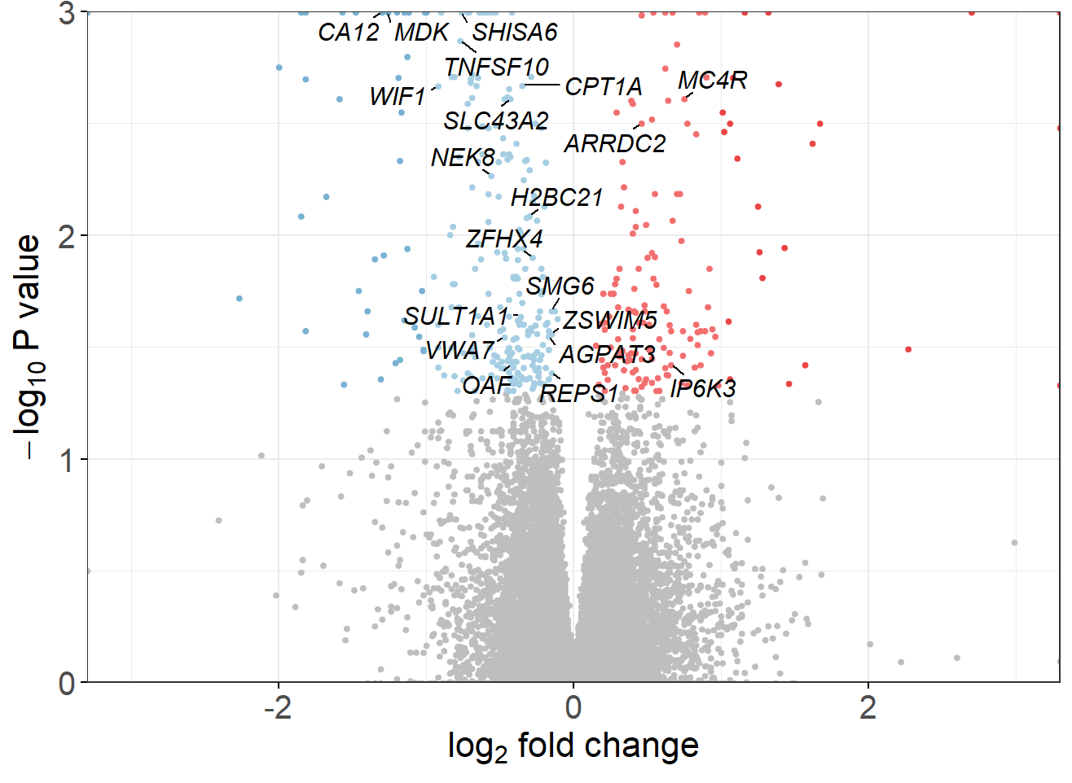
A
B
Log fold change
1e+00 1e+0.2 1e+0.4 1e+0.6
C
Mean of Normalised Values
D
Log fold change
1e+00 1e+0.2 1e+0.4 1e+0.6
E
Mean of Normalised Values

Slide 3
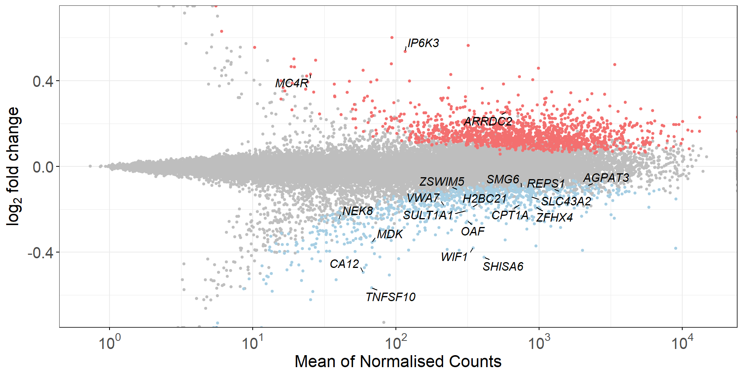
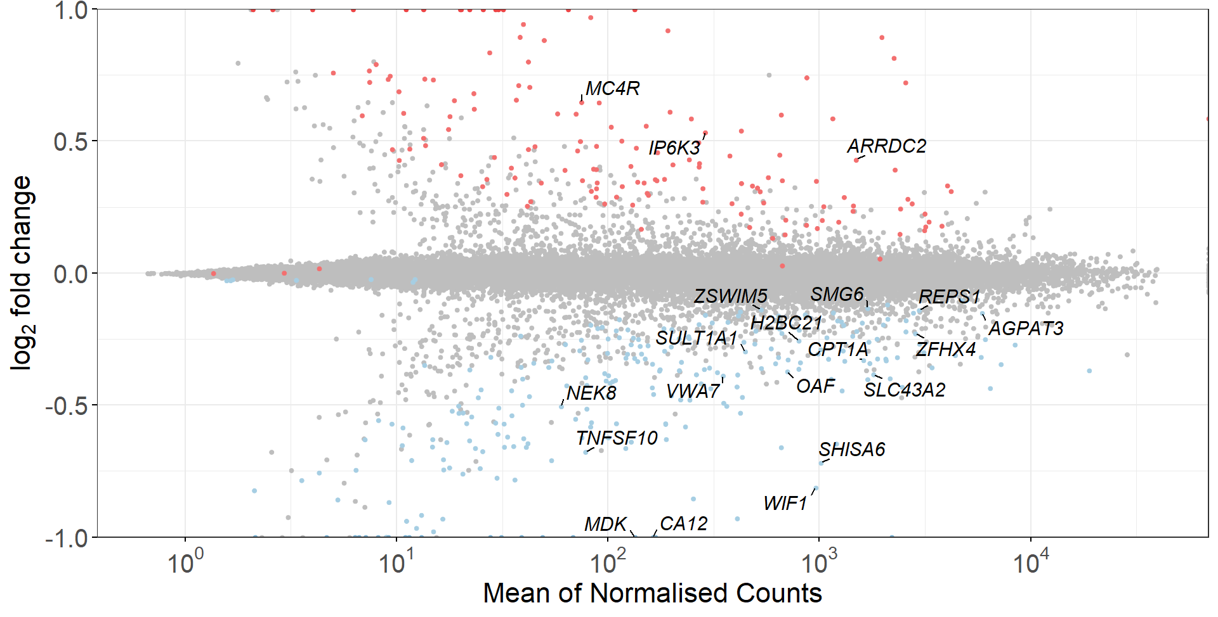
A
B
C
D
E

